Slide 1
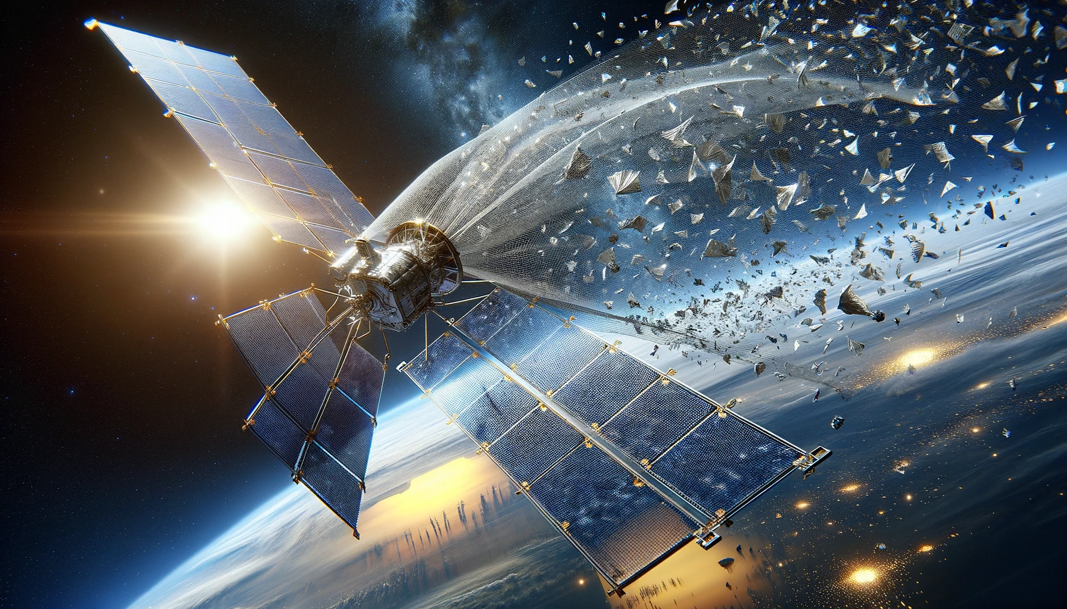
SPACE SIEVE
Rishi Manohar Manoharan Rishikesh Ramesh Subhiksha Murugesan Nagul Pandian Nithish Kumar Senthil Kumar

Slide 2
Objective
Space Object Identification Model
Development Goal: Automate the distinction between active satellites and space debris through image analysis.
Key Task: Identify operational vs. non-operational orbiting objects.
Data Integration:
Merge two unique datasets for comprehensive coverage.
Account for varying debris sizes to simulate collision scenarios.
Resilience Focus:
Ensure robust analysis capable of adapting to collision aftermaths.
Our model strives to provide reliable identification crucial for space traffic management and collision avoidance.

Slide 3
Stake holders
Enhancing Space Operations Safety and Sustainability
Space Agencies (e.g., NASA, SpaceX): Conduct space exploration and deploy satellites; require advanced debris management to safeguard missions.
Telecommunication Providers: Depend on satellites for communication; need debris control for uninterrupted services and infrastructure protection.
Material Producers for Spacecraft: Supply durable, debris-resistant materials; their innovation is driven by satellite design demands.
Government Sector: Invests in space infrastructures; aims to reduce debris-related financial losses.
Our Objective: Provide stakeholders with sophisticated tools for the identification, classification, and management of space debris to ensure the enduring safety and sustainability of space operations.

Slide 4
THE data
SPARK Datasets: Enhancing Spacecraft Detection & Trajectory Estimation
Hosted by: University of Luxembourg's CVI² at SnT.
Datasets: SPARK2022 & SPARK2021.
Key Features:
High-Resolution Images: 110,000+ RGB images.
Diverse Classes: 10 spacecraft types & 1 space debris category.
Annotations: Object bounding boxes & class labels.
Varied Conditions: Simulations under diverse space scenarios for realism.
Data Quality:
Synthetic & Real Data Blend: Enhanced fidelity using advanced simulations and Zero-G Lab experiments.
Quality Assurance: Rigorous checks for accuracy & consistency.
Dataset Reliability:
Collaborative Effort: Backed by leading space agencies ensuring authenticity and quality.
Research Usability:
Rich Metadata: Supports a spectrum of research from object detection to scenario analysis.

Slide 5
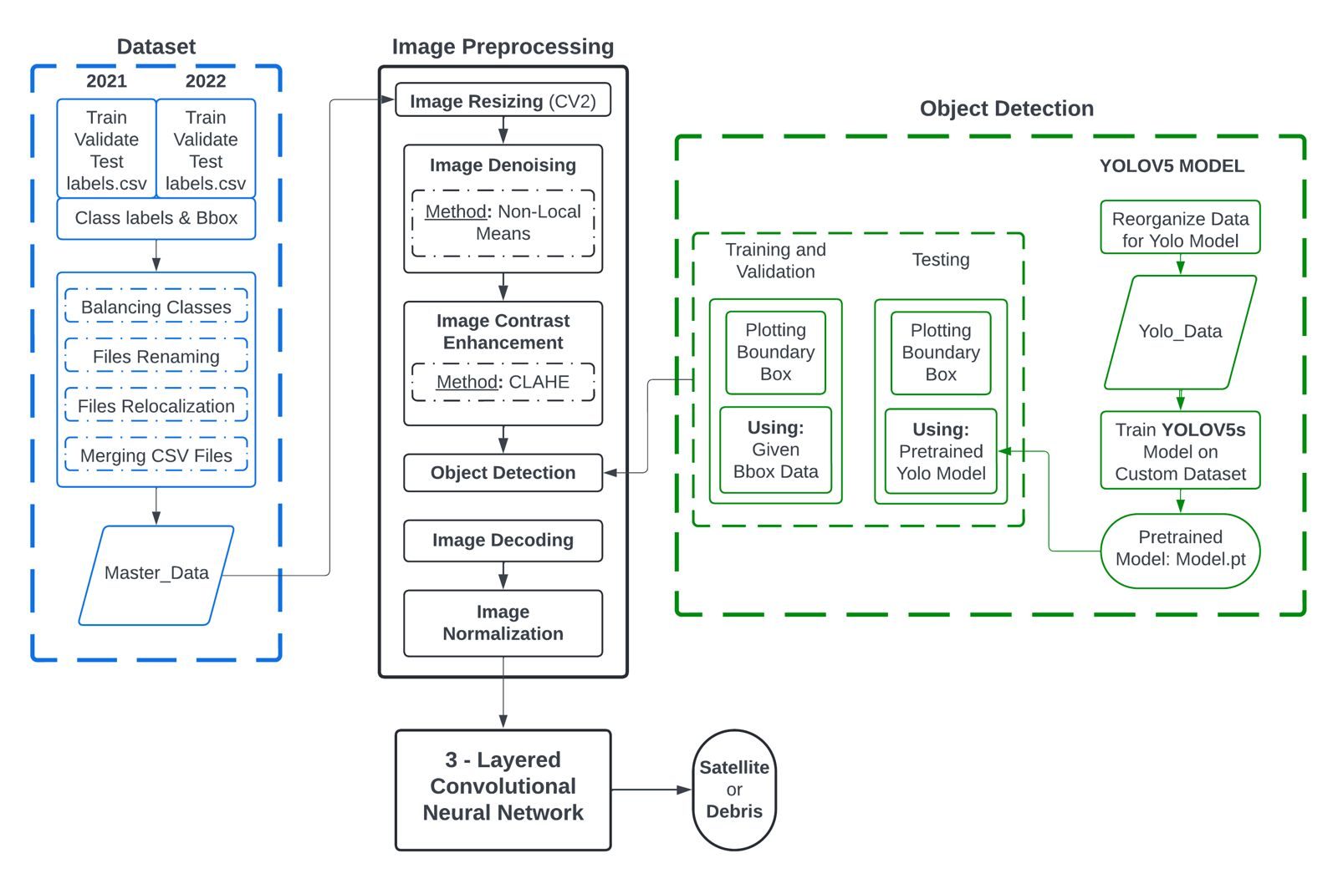
Model Architecture

Slide 6
MODELING Approach
Image Preprocessing & Object Classification Workflow
Image Preprocessing Steps:
Resize images for consistency.
Augment data to introduce diversity.
Convert images to a standard format.
Apply noise reduction for enhanced clarity.
Object Detection & Segmentation:
Utilize Mask-RCNN for high-precision object detection.
Achieve accurate localization and detailing of satellites and debris.
Classification via Convolutional Neural Network (CNN):
Self-deployed CNN for distinguishing space debris from active satellites.
Evaluation Metrics for Model Reliability:
Emphasis on Precision, Recall, and F1 Score to ensure:
Accurate predictions.
High reliability of the model's outputs.

Slide 7
Thank you

